Slide 1
Fire Safety Regulations: Then and Now
Breakout Session 1
Mark Field, Cardinus
Integrate
Breakout Room

Slide 2
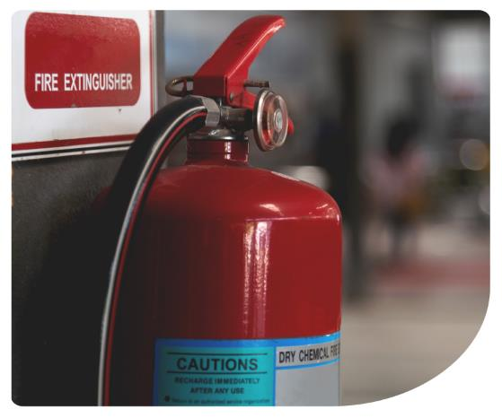
Fire Safety Regulations Then and Now
Mark Field, Senior Fire Risk Consultant,
Cardinus Risk Management

Slide 3
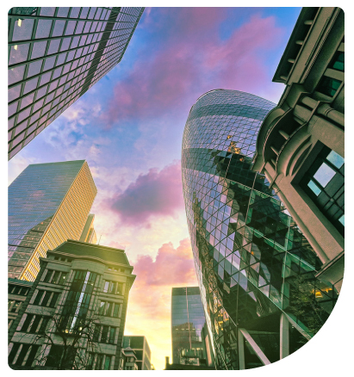
About Cardinus
Established 1995
Part of AmWINS Group Inc, a $2.5 billion premium wholesale insurance broker
Nationwide on-site risk management services
We carry out over 12,000 Insurance Risk Surveys, Risk Assessments, Audits and Reinstatement Cost Assessments (RCAs) each year
We have £10m Professional Indemnity insurance cover
We’re ISO accredited, regulated by RICS and our Fire Risk Assessments are BAFE ‘Gold ‘certified.

Slide 4
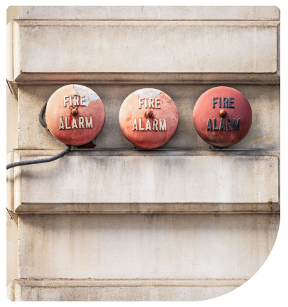
Historic Fire Safety Regulations
Wooden Chimneys: In medieval England, chimneys were sometimes built from wood, posing a significant fire risk until laws prohibited them.
Curfew: The term 'curfew' comes from the French word 'couvre-feu,' meaning 'cover the fire.' In medieval times, curfews were enforced to prevent fires at night.
The Great Fire of London 1666: One of the most devastating urban fires, leading to the development of fire regulations, including the first Fire Insurance schemes. 6 recorded deaths – poor and homeless not recorded
19th Century Building Codes: Introduction of brick and stone as required materials for urban buildings to prevent fire spread.
Notes:
Let's start with a few fun and surprising facts about historic fire safety. In medieval England, chimneys, an essential part of homes, were often made of wood! Of course, the fire hazard was immense until this practice was banned. Similarly, have you ever wondered where the word 'curfew' comes from? It traces back to the French phrase 'couvre-feu,' meaning 'cover fire.' Curfews were originally enforced to ensure that people extinguished fires before going to bed, to reduce the risk of nighttime blazes. These fun historical facts highlight how fire safety has evolved dramatically over time.
Following these fun facts, let's now explore some pivotal moments in the development of fire safety regulations in the UK. The Great Fire of London in 1666 was a tragedy that destroyed a significant portion of the city. But it also led to critical advancements in fire safety. As a response, the city began developing fire codes, and even introduced the first-ever fire insurance schemes. Fast forward to the 19th century, and we see further regulation with the mandate to use non-flammable materials like brick and stone in city construction, ensuring safer and more fire-resistant cities. These early regulations have had a lasting influence on modern building safety codes.

Slide 5
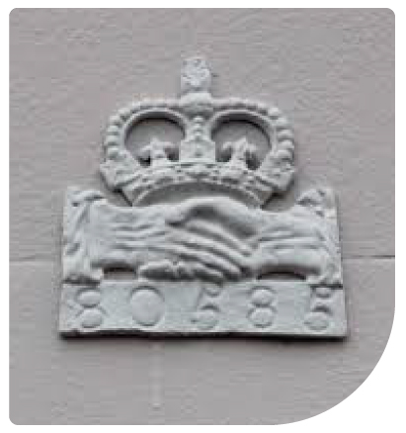
Insurance and Fire Safety Regulations
Those who could afford it paid insurance companies with watchmen to raise the alarm and crews to put out the fires.
Insurance companies competed for business and sometimes they even fought over water supplies.
Nobody went into a fire to try to fight it, they all just tried to pour water in through windows from buckets, mostly to no avail and most of the properties were actually burned down.
1824 - The Edinburgh Fire Engine Establishment was the first fire brigade in the world paid for by the city, free to the public.
1833 - London Fire Engine Establishment.
Notes:
The Edinburgh Fire Engine Establishment, founded in 1824, is often credited as the world's first municipal fire brigade. It was established by James Braidwood, who is regarded as a pioneer in firefighting. The brigade was funded by the City of Edinburgh, making it a public service rather than a private one, and it was free to the city's residents.
Before this, firefighting was generally a private or insurance company-funded activity. The success of the Edinburgh model influenced the development of similar fire services in other cities, including London's. Braidwood later became the first chief of the London Fire Engine Establishment in 1833.
So, indeed, the Edinburgh Fire Engine Establishment set a precedent as the first fire brigade paid for by the city and free to the public.

Slide 6
Current Fire Safety Regulations
Regulatory Reform (Fire Safety) Order 2005. replaced over 70 pieces of legislation!
Fire Safety Act 2021 & The Building Safety Act 2022 enforce stricter safety measures.
Clarification on the scope of fire safety responsibilities, especially around cladding and external wall systems in residential buildings.
Fire Safety (England) Regulations 2022: Mandates for smoke control systems, evacuation lifts, and fire doors.
Fire risk assessments must be updated regularly by responsible persons - Regulatory Reform (Fire Safety) Order 2005.

Slide 7
Impact on Property Owners and Freeholders
Building safety certification and mandatory fire risk appraisals for external wall systems on residential blocks.
Introduction of Accountable Persons to manage building safety risks for high-rise structures.
Increased responsibilities for property managers, landlords, freeholders, and managing agents.
Non-Compliance: Failure to comply with the regulations could lead to serious legal and financial consequences, including fines or prosecution, especially if non-compliance results in harm during a fire incident.

Slide 8
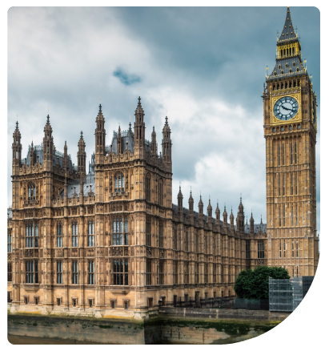
Government Priorities
Building Safety Regulator established to oversee safety in all new and existing high-rise buildings.
Implementation of a Resident Engagement Strategy to involve occupants in safety decisions.
Prioritising removal of dangerous cladding from residential buildings, with a multi-billion-pound fund.
Emphasis on improving emergency evacuation plans and communication systems for residents.

Slide 9
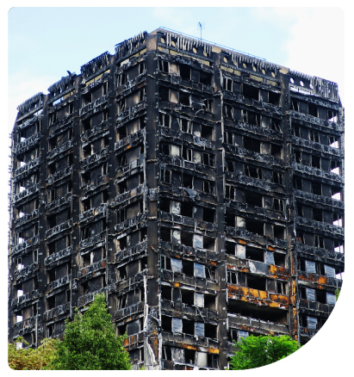
What’s next for Fire Safety Regulation?
The future of fire safety regulation in the UK is expected to continue evolving, driven by lessons from the Grenfell Tower fire, advancements in construction technology, and the increasing focus on safety and accountability in the built environment.
Comprehensive Risk Assessments: It is anticipated that there will be new mandates for more detailed and frequent fire risk assessments, particularly in high-rise and high-risk buildings.
Building Safety Files: Fire safety data to be kept in digital format, forming part of the building’s “Golden Thread” of information, ensuring safety-critical information about the building’s structure and fire safety systems is easily accessible to both managers and emergency services.

Slide 10
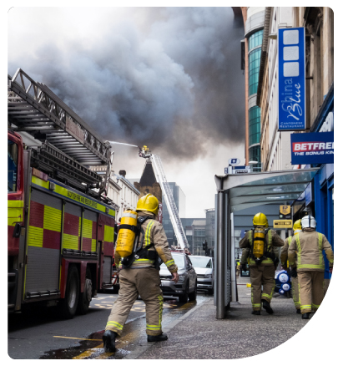
Fire Safety Regulation - Conclusion
The future of fire safety regulation will prioritise greater accountability, the use of modern technology, and comprehensive risk assessments to ensure that all residential buildings—especially high-rises—are as fire-safe as possible.
Property owners, managers, and responsible persons will need to stay informed and proactive, adapting to these changes to ensure compliance and safeguard the lives of residents.
As fire safety becomes increasingly interconnected with broader building safety regulations, multidisciplinary approaches will be critical, combining fire safety with structural integrity, sustainability, and resident well-being.

Slide 11
Fire Safety Questions

Slide 12
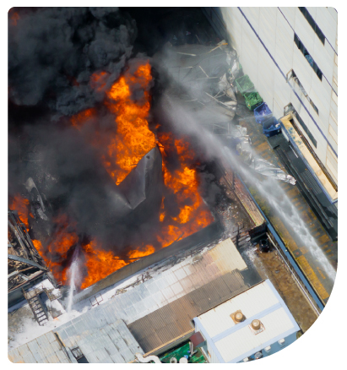
RCA - Are you covered if the worst happens?
Without adequate insurance, you risk significant financial loss if a building is destroyed by fire.
Underinsurance results in lower claim payouts, potentially covering only a portion of rebuild costs.
Rebuilding to new safety regulations post-disaster can dramatically increase costs.

Slide 13
RCA - Are you covered if the worst happens?
Average clause: Insurers may apply this, reducing claim amounts if the building is found to be underinsured.
If the insured value of the property is less than the full cost of reinstatement (rebuilding), the insurer may reduce the amount of any claim by the same proportion. For example:
If a property should be insured for £1M but is only insured for £500,000, the insurer considers the property to be 50% underinsured.
In the event of a claim for £200,000, the insurer could apply the average clause and only pay 50% of the claim, or £100,000.

Slide 14
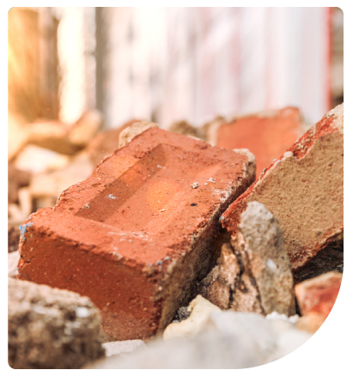
How to address underinsurance
RCAs provide an accurate snapshot of rebuild value at the time of assessment.
Regular updates are essential for maintaining sufficient insurance coverage.
Insurance risks increase without updated RCAs, leading to potential underinsurance.

Slide 15
RCA validity and insurance implications
RCAs are valid for three years, with RICS recommending a new assessment afterward.
Annual adjustments account for inflation and other variables.
Insurers may require a professional RCA every three years to waive the ‘Average’ clause, which could otherwise reduce claim payouts in case of underinsurance.

Slide 16
Annual revaluation and cost-effective solutions
Annual revaluation is recommended for optimal security.
Cardinus offers on-site and desktop RCAs, with desktop assessments as a cost-effective method for yearly updates.
Desktop RCAs are accurate, convenient, and reliable for simple properties.

Slide 17
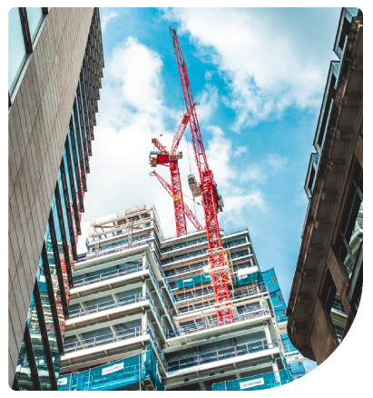
Key factors impacting rebuild value
Structural changes: Modifications like property extensions increase rebuild value.
Economic factors: Inflation and fluctuating labour/material costs affect rebuild estimates.
Regulatory updates: Changes in building codes raise restoration costs.
Technological advancements: Innovations in materials and building practices increase rebuild costs.

Slide 18
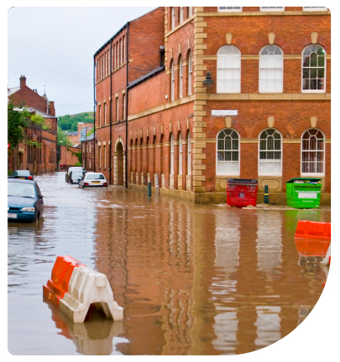
Environmental and market influences
Environmental factors, including natural disasters, impact rebuild costs.
Local market conditions, such as construction demand, influence labour and material pricing.

Slide 19
How Cardinus protects against underinsurance
Cardinus is RICS-regulated and provides expert, nationwide RCA services.
Using advanced technology, we ensure RCAs are accurate and cost-effective.
Contact us at property@cardinus.com to safeguard your property from underinsurance.

Slide 20
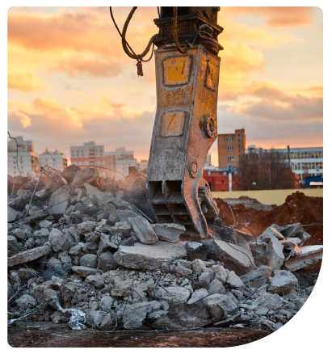
RCA - Conclusion
The average building reinstatement cost can vary widely depending on factors such as property size, location, and specific building features.
Regular RCAs are crucial for property owners to avoid the risks of underinsurance and over insurance.
By ensuring the property is accurately valued for insurance purposes, owners can protect themselves from significant financial losses in the event of a disaster.

Slide 21
New Building Safety Case Report Service
Evidence the safety of your buildings with our new Building Safety Case Reporting Service.
Use our market-leading property risk management software (INDIGO) to seamlessly gather Golden Thread Information and create your Building Safety Case Reports.
Go to the Cardinus stand to see how the service works.

Slide 22
Get the best protection for your people and properties
Find out more
cardinus.com

Slide 23
Thank you for listening. Any Questions?

